Slide 1
Meeting 25-2-2022 Overview of progress and plans
Joren Janzing

Slide 2
Content
Overview of progress so far: -PACE results -MITgcm results
Plans for the coming months

Slide 3
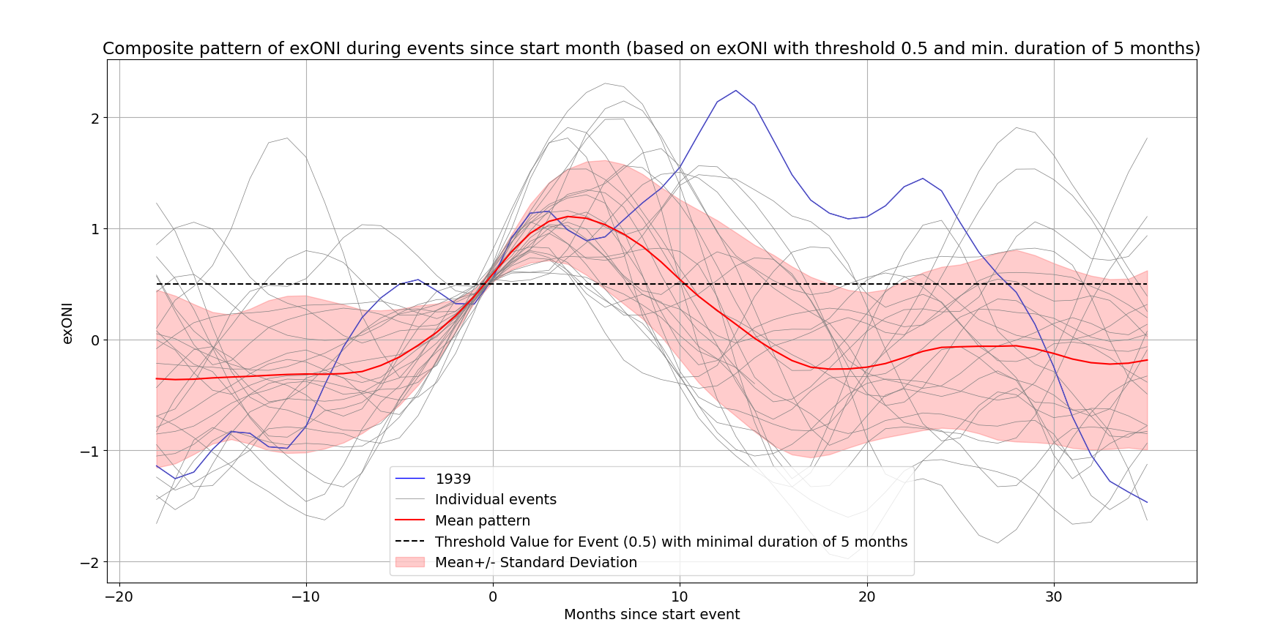
ONI over threshold of 0.5 for a minimal duration of 5 months (NOAA definition).
Time in months since the start of the detection.
Blue line shows the 1940 event.

Slide 4
PACE Ensemble results
Mainly studying the zonal winds over the Amundsen Sea

Slide 5
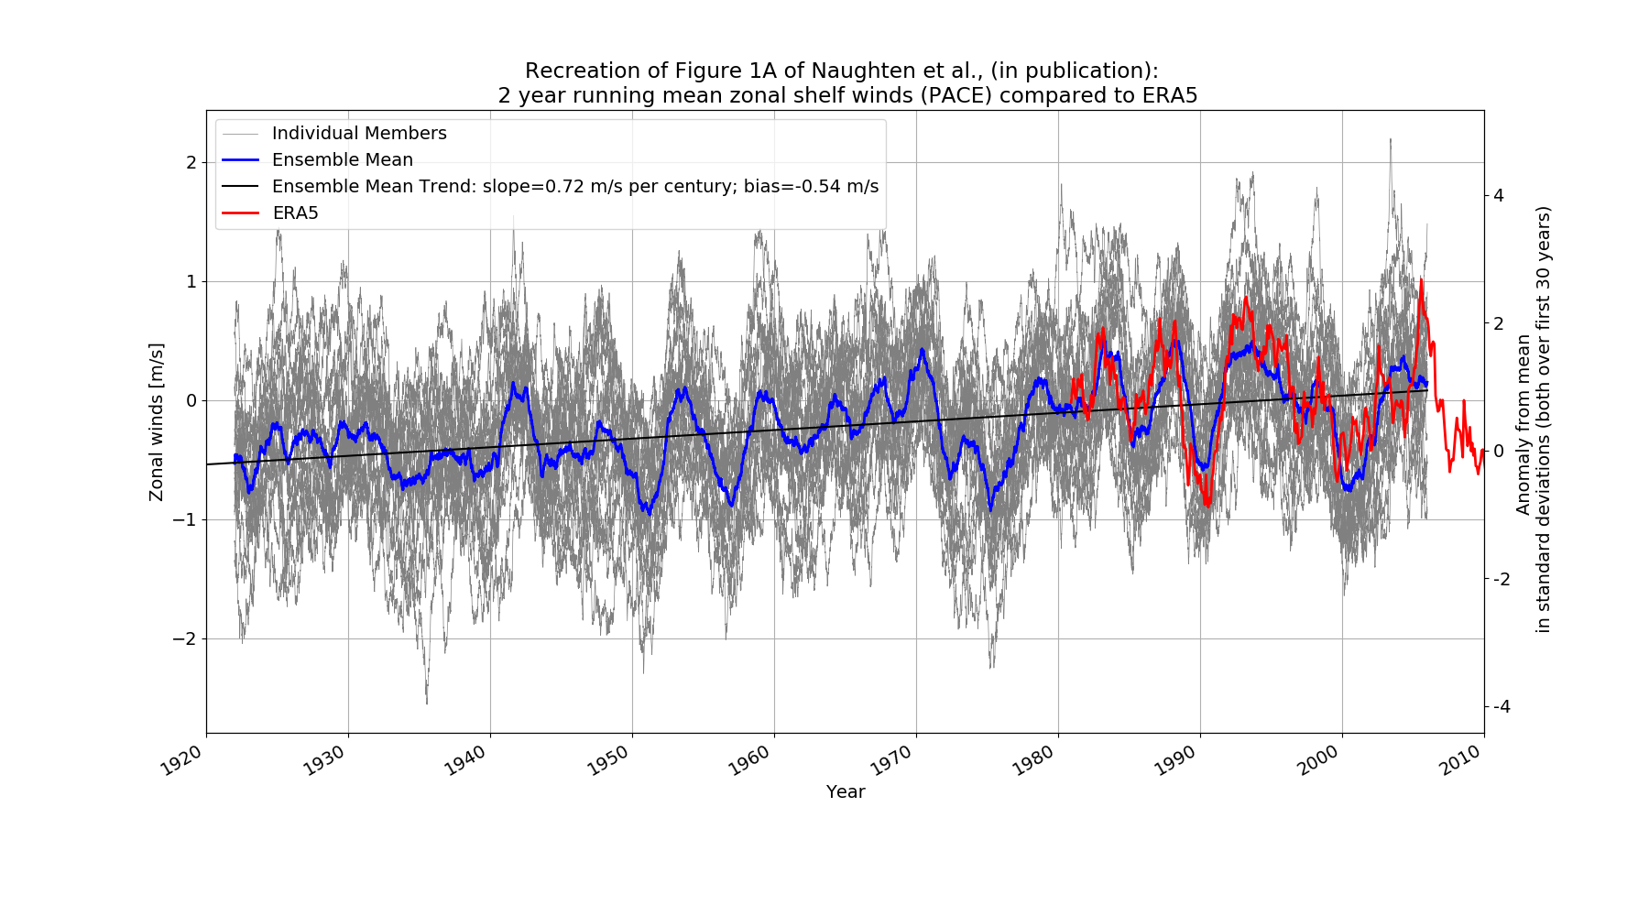
Clear Positive Zonal Wind Anomaly over Shelf Break

Slide 6
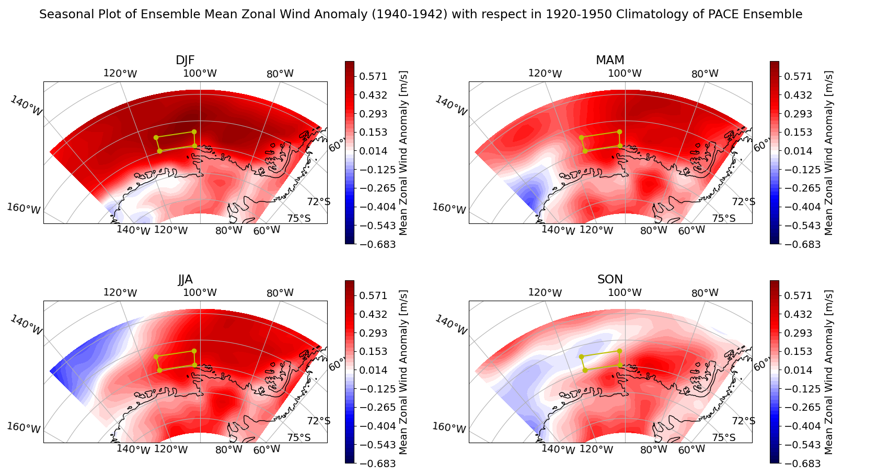
Clear Positive Zonal Wind Anomaly

Slide 7
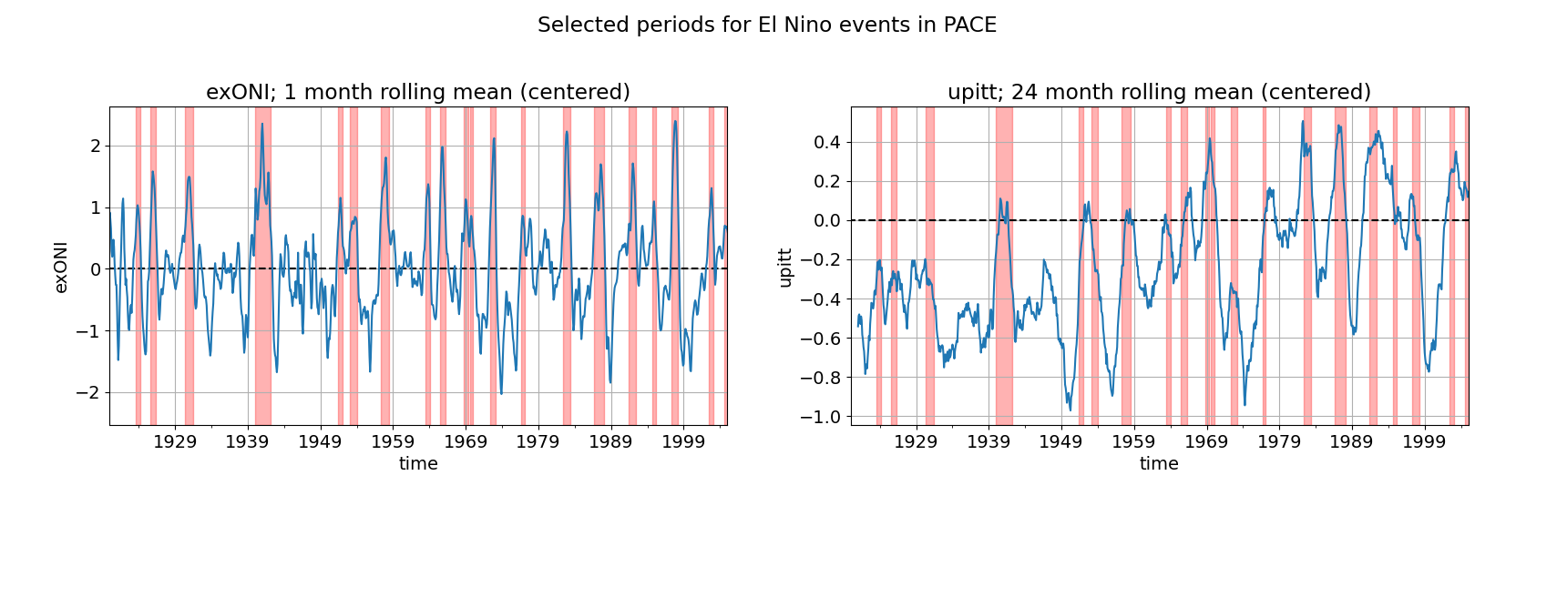

Slide 8
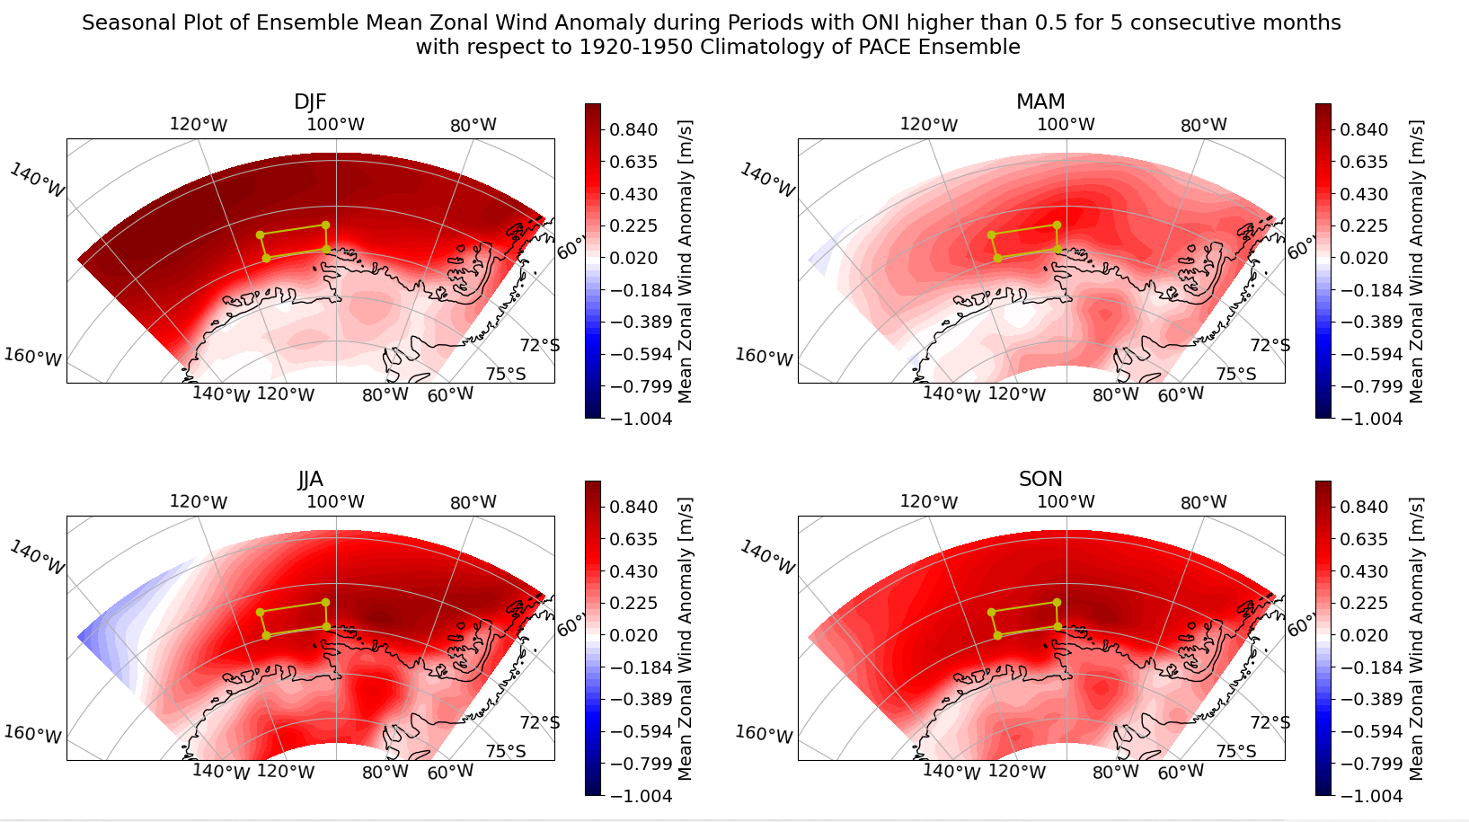
Similar Pattern as Mean ENSO
z

Slide 9
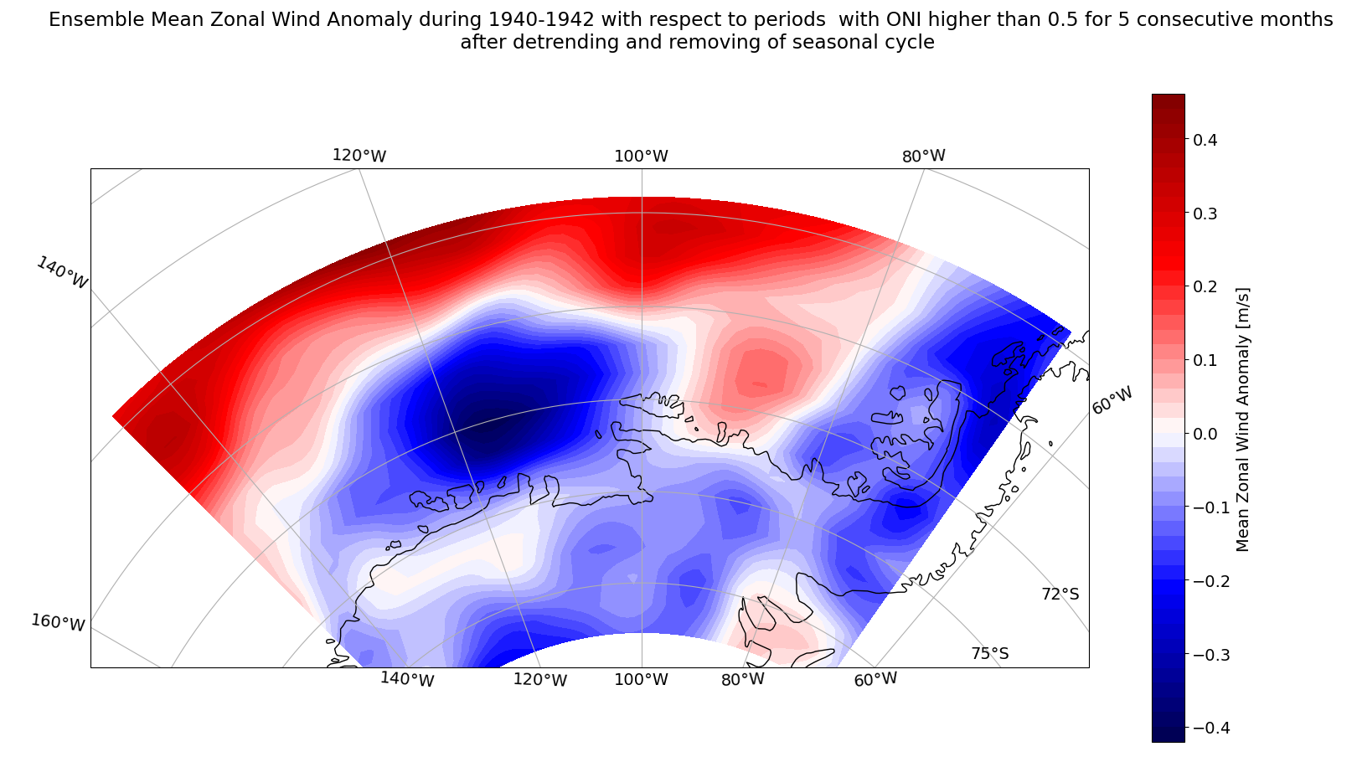
Wind response seem weaker than mean ENSO

Slide 10
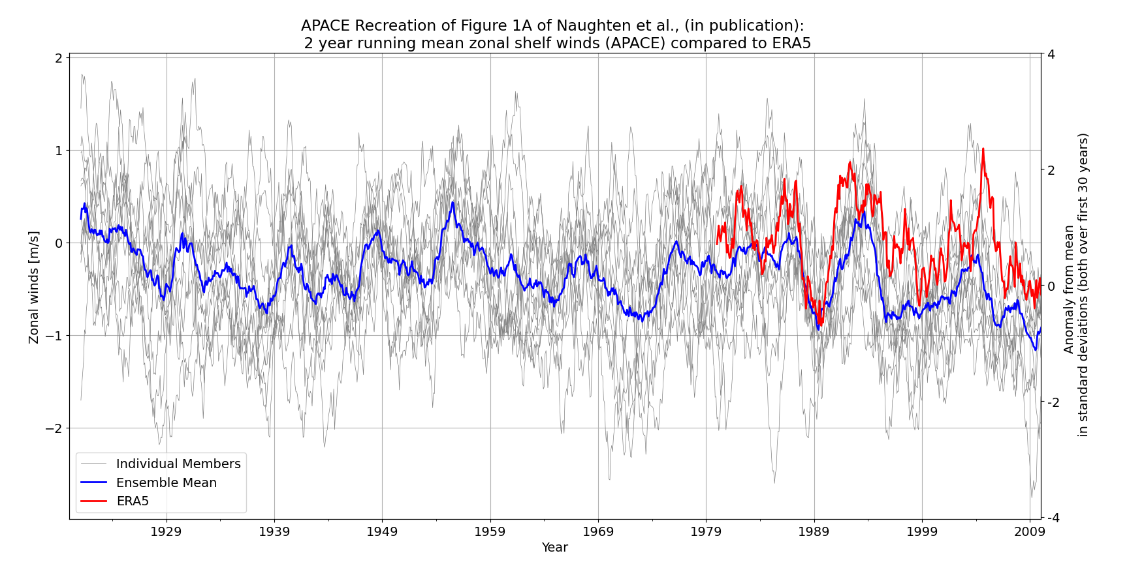
APACE ensemble

Slide 11
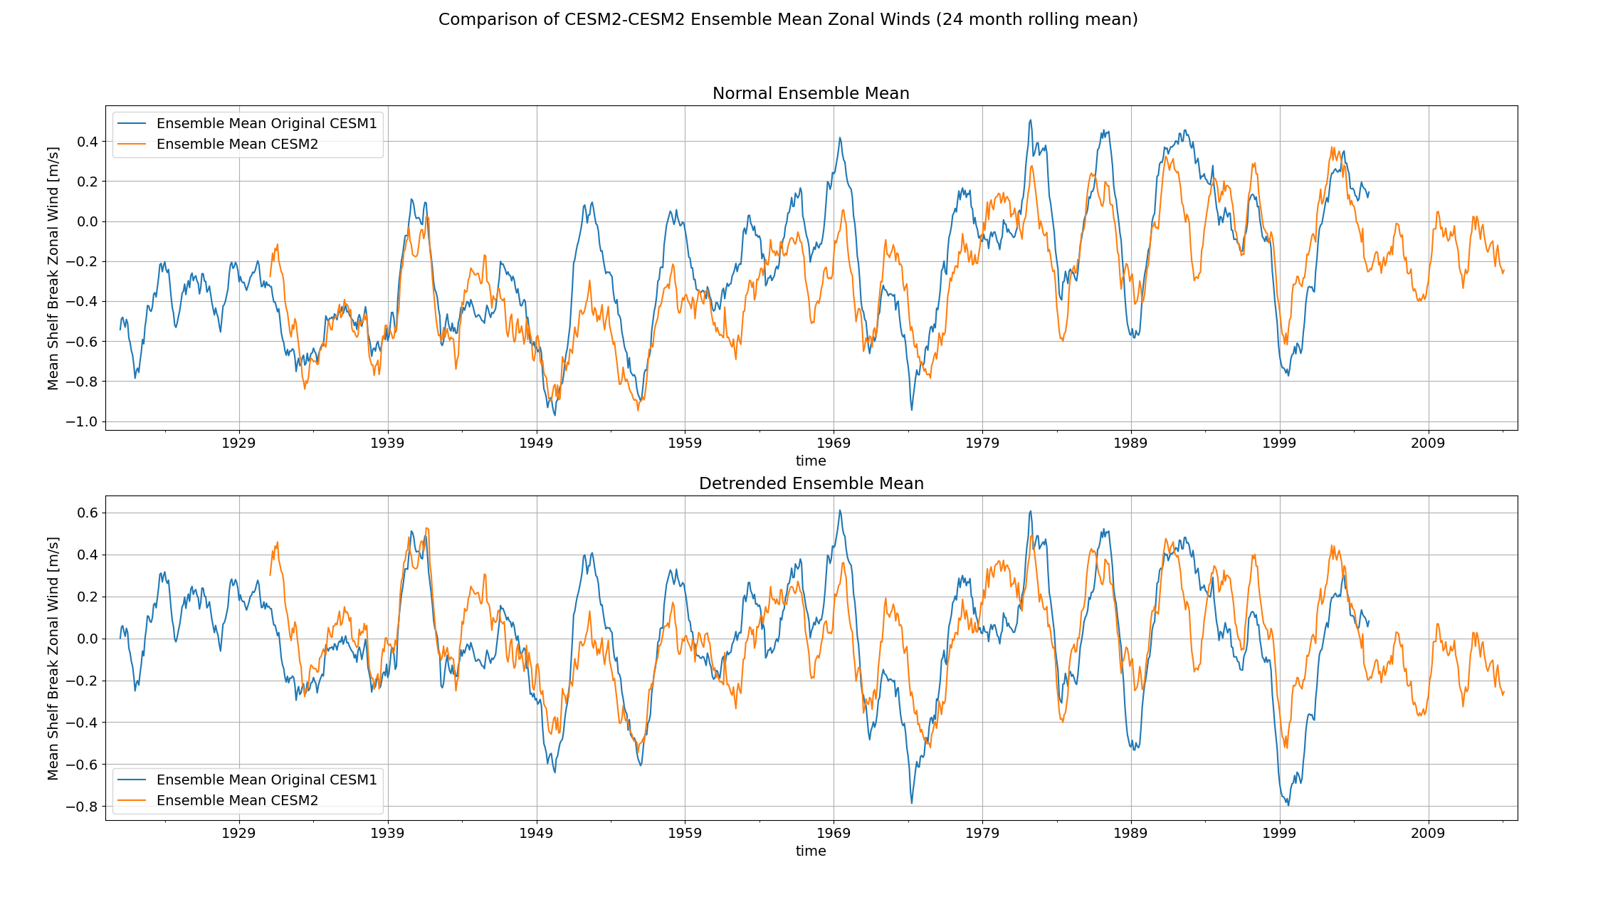
New CESM2 PACE ensemble
1

Slide 12
Are the 1940s an exceptional time for zonal shelf winds?
Positive zonal wind anomaly in all seasons over 1939-1942 period
First peak of its kind in the dataset. Could be a threshold?
Not necessarily the strongest anomaly.
ENSO like pattern, but weaker at shelf edge?
Other factors could play a role, which are not in PACE ensemble.

Slide 13
MITgcm results
MITgcm forced by the PACE ensemble for the Amundsen Sea region.

Slide 14
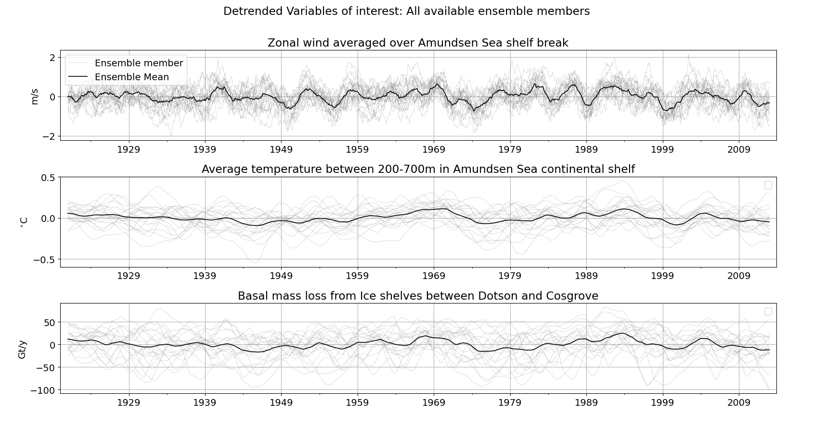
Not a lot happening in the ensemble mean…

Slide 15
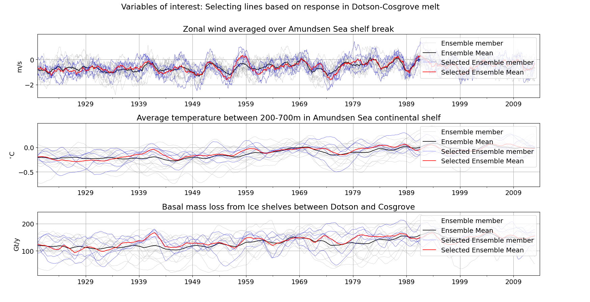
Are there ensemble members that show a strong increase in melting in the 1940s?

Slide 16
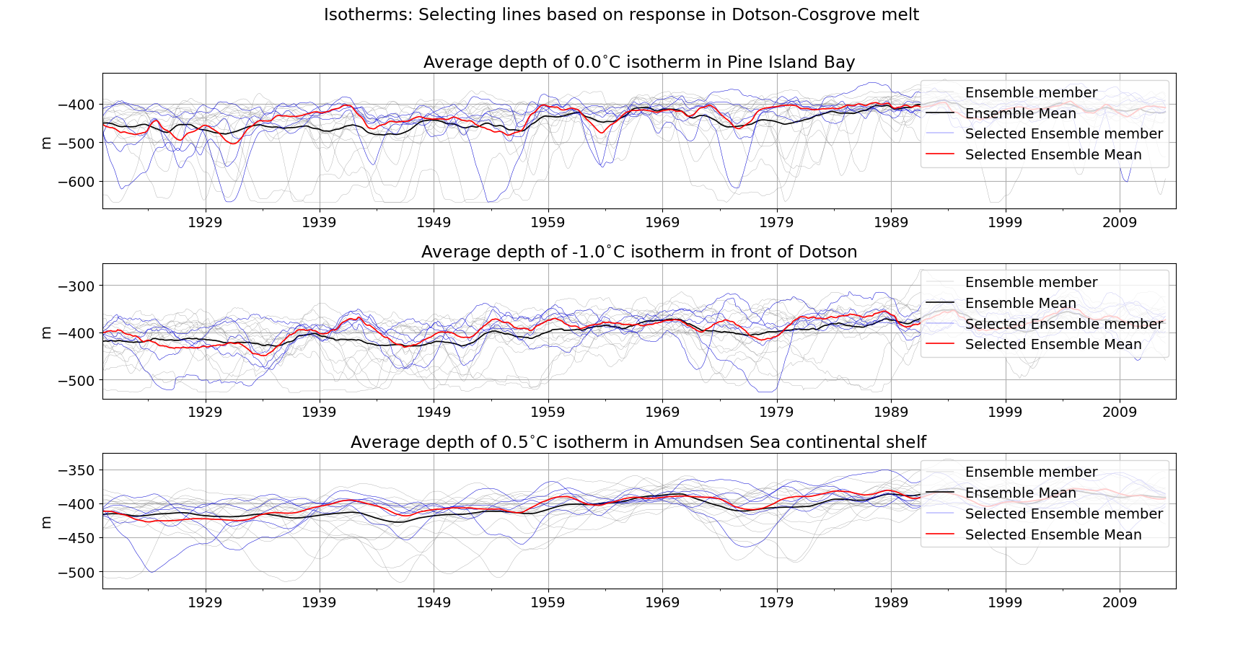
What do they have in common?

Slide 17
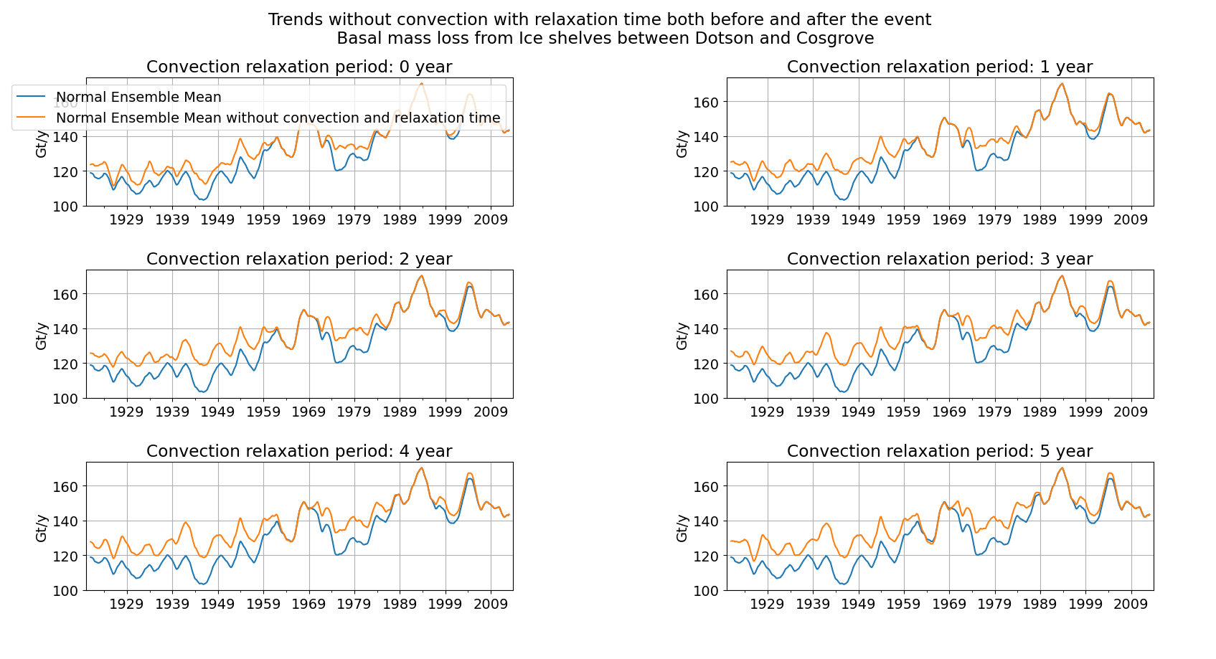
Slightly stronger response when removing convection

Slide 18
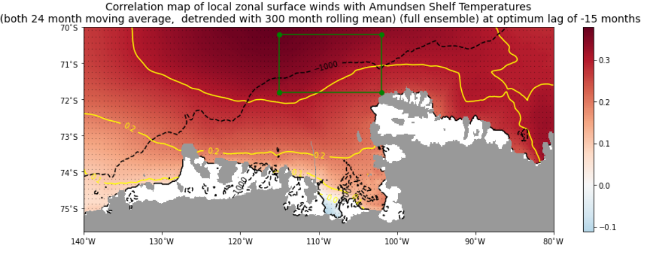
Correlation maps: what regions are influential in the model

Slide 19
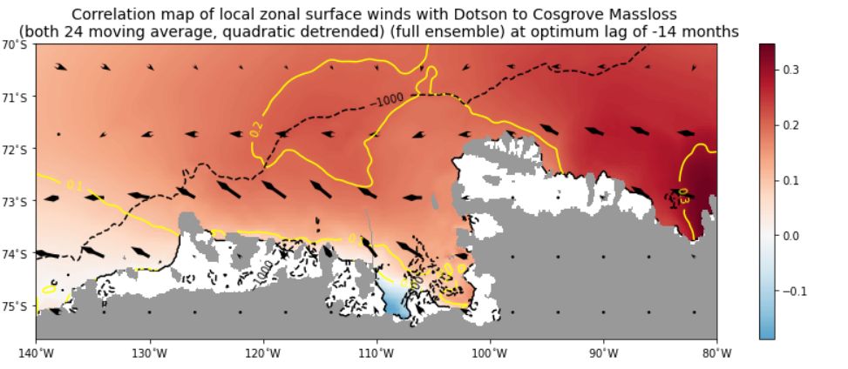
Correlation maps: what regions are influential in the model

Slide 20
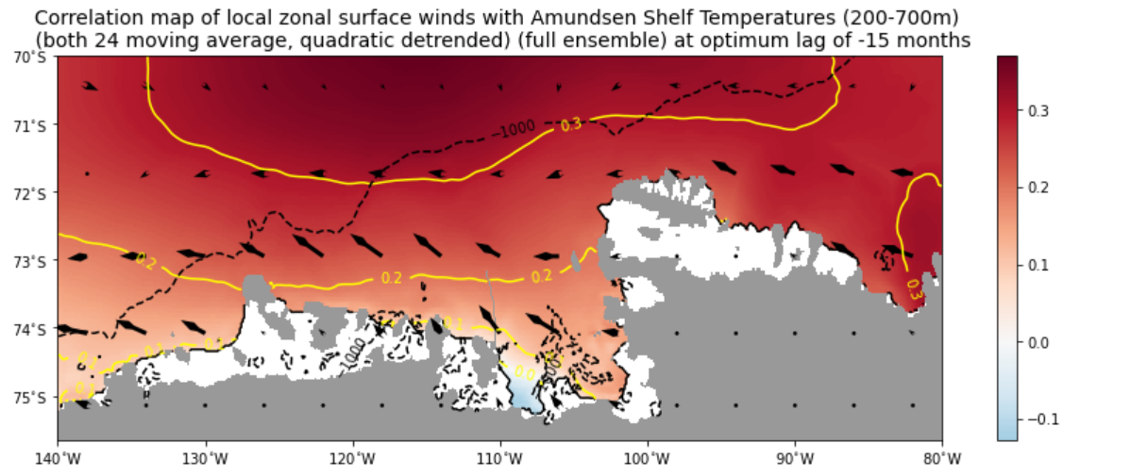
Correlation maps: what regions are influential in the model

Slide 21
Summary
MITgcm regional model does not show a very strong response in 1940s.
Could be masked by convection in the model.

Slide 22
Plans for the coming months
Further analysis of the MITgcm output
Composites of strong melt anomalies. What is the average evolution over time? Is the 1940s different?
Removing convection and see how composites and correlation maps change.
Possibly new model runs
Further analysis of the PACE output
Further comparing CESM2 and CESM1 PACE.
Maybe looking at different effects on the PITT winds?

